Slide 1
Class Diagram Problems

Slide 2
Problem No.-1
A bank has many branches. In each zone, one branch is designated as the zonal head office that supervises the other branches in that zone. Each branch can have multiple accounts and loans. An account may be either a savings account or a current account. A customer may open both a savings account and a current account. However, a customer must not have more than one savings account or current account. A customer may also procure loans from the bank.

Slide 3
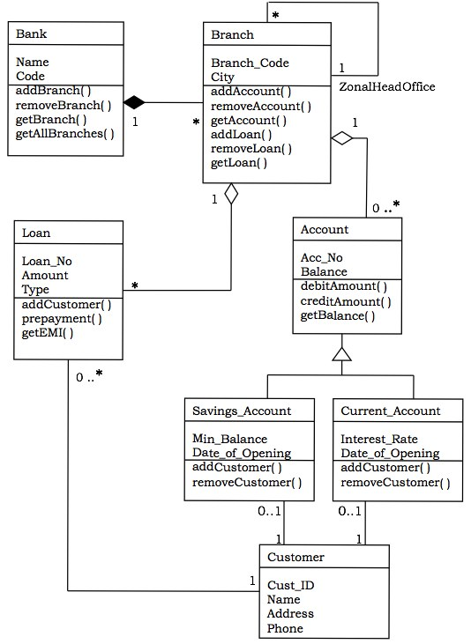
The following figure shows the corresponding class diagram.

Slide 4
Discription
Relationships
A Bank “has–a” number of Branches − composition, one–to–many
A Branch with role Zonal Head Office supervises other Branches − unary association, one–to-many
A Branch “has–a” number of accounts − aggregation, one–to–many
From the class Account, two classes have inherited, namely, Savings Account and Current Account.
A Customer can have one Current Account − association, one–to–one
A Customer can have one Savings Account − association, one–to–one
A Branch “has–a” number of Loans − aggregation, one–to–many
A Customer can take many loans − association, one–to–many

Slide 5
Problem No-2
A user my login with Customer or Administrator.
Being a customer he can place an order with order detailes
Being a Administrator he can update products.
Draw a class diagram

Slide 6
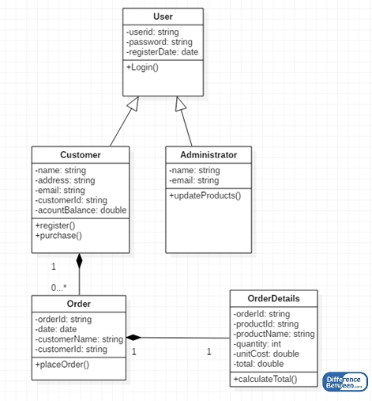

Slide 7
Problem No:-3 Class diagram for ATM

Slide 8
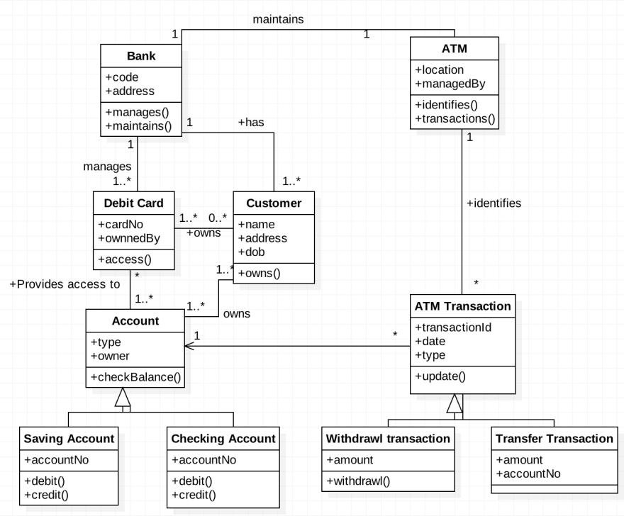

Slide 9
Problem No:-4
Class Diagram for Library Management System

Slide 10
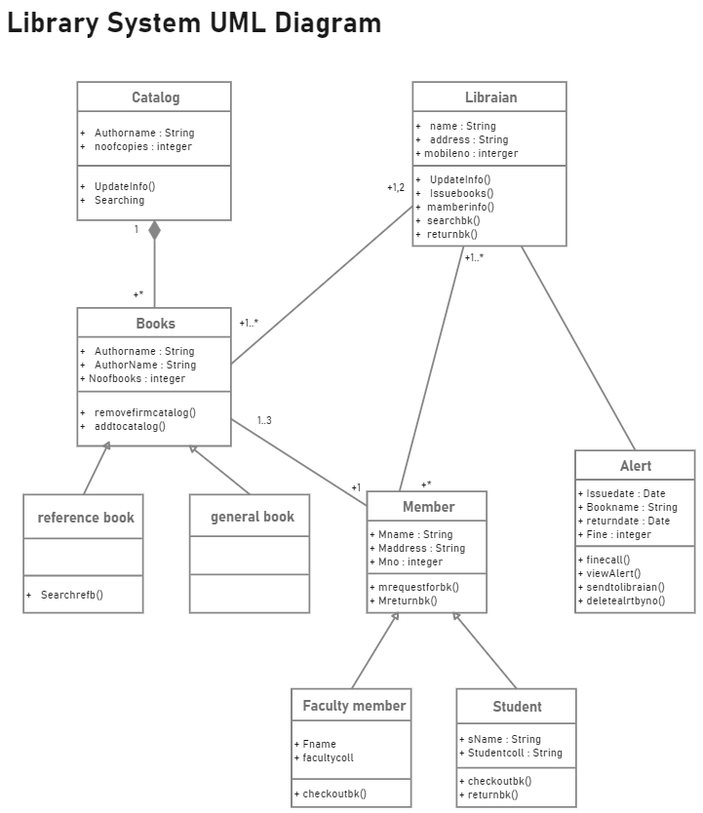

Slide 11
Problem No:-5
Class Diagram for Hospital Management System

Slide 12
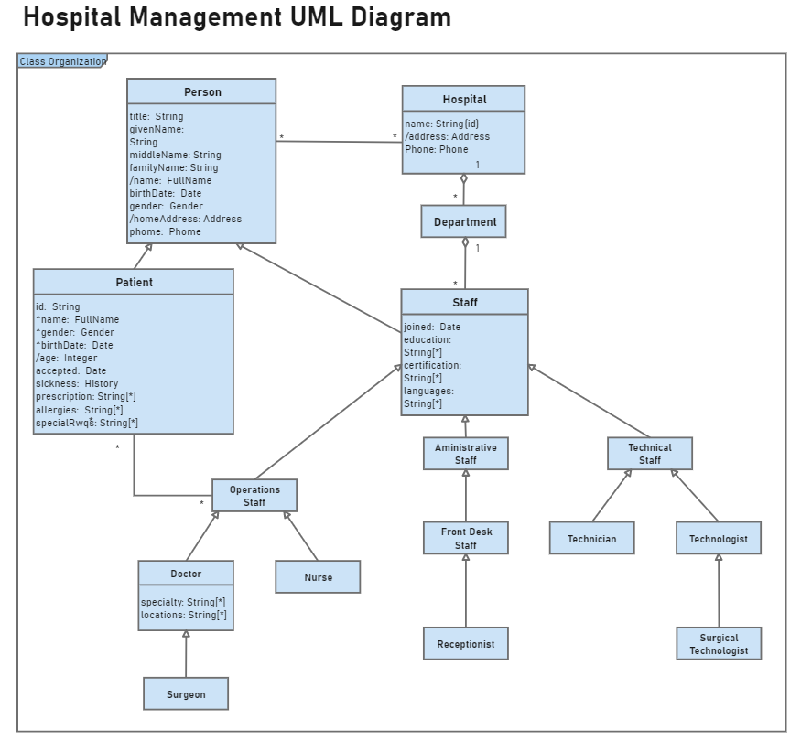

Slide 13
Problem No:-
Class Diagram for Hotel Management System

Slide 14



